Slide 1


How easy is it for players to complete a navigational task within a Non-Euclidean virtual environment?
Oliver Tennant – BSc Computing

Slide 2
What is Non-Euclidean geometry?
Euclidean geometry is the study of flat surfaces and finds the shortest possible route.
Non-Euclidean does a similar thing (finds the shortest method between two points) but uses spherical surfaces instead.
(X2, Y2)
Euclidean distance
Y2 – Y1​
(X1, Y1)
X2 – X1​​

Slide 3
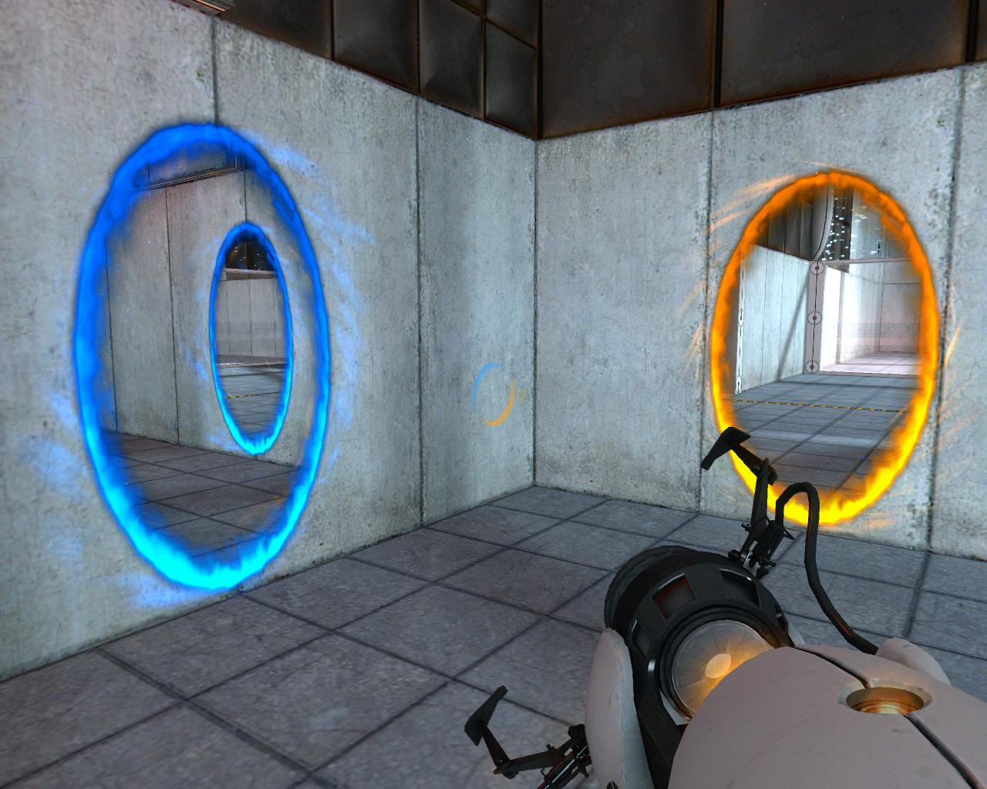
How has this been used in games?
The Portal game series uses this technique to achieve the dual portal system. This allows the player to enter through one portal and come out of another at separate point of the map seamlessly.

Slide 4
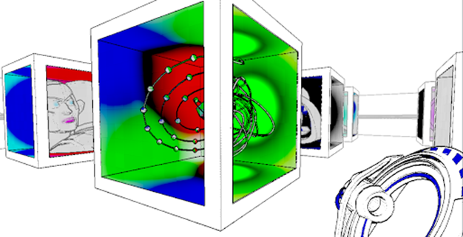
Anti-chamber is also a game that uses numerous types of Non-Euclidean geometry to achieve different things. Examples include: Looping corridors, portals, multiple objects existing within other objects and countless others.
Notes:
Anti-chamber is unique in its delivery. It either makes the player intrigued, uneasy or disorientated. But it also gives the player a sense of wonder when discovering the mechanics. Since they make you thing outside the box.

Slide 5
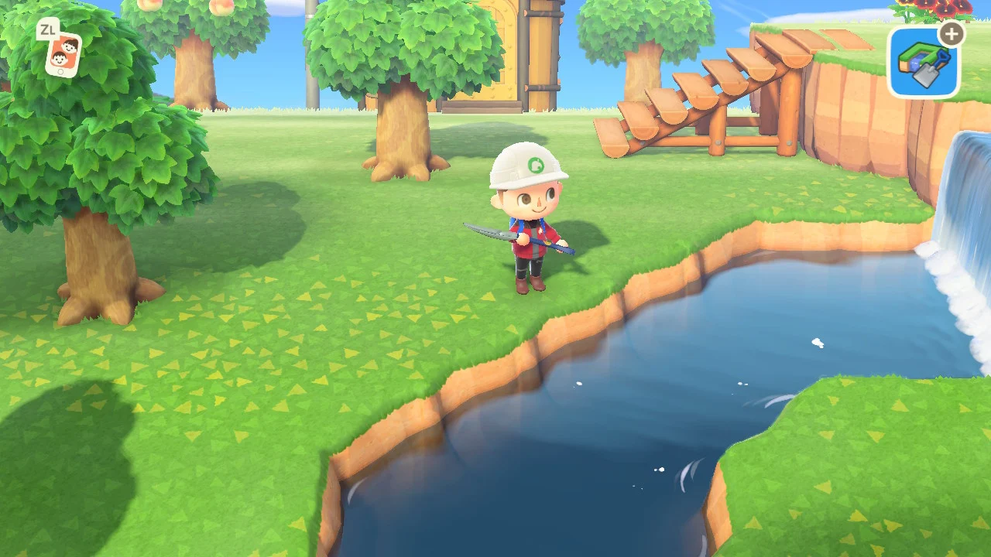
Now for a game that isn’t in the puzzle genre. We have Animal Crossing. This game uses Non-Euclidean geometry to achieve the spherical plane that always appears like its curving with the players movement.

Slide 6
Have there been any real life Non-Euclidean tests?
Within the paper "Journal of Experimental Navigation: Non-Euclidean navigation", it is mentioned that they conducted a test which involved an assortment of rats and a maze that was constructed on an elevated, spherical surface. This test were to gather behavioural evidence for metric cognitive maps.
Notes:
The aim of the experiment were to train the rats to go a certain path to acquire a food package. Then, when the rats memorised the path, they would change the scenario in a way that corresponds to the previous layout but blocks off some of the original paths. Not only this, the end goal had been lit with a lamp to act as a beacon to give the rats a sense of direction. After the experiment concluded, it was recorded that only 36 percent of the test subjects subconsciously went towards the familiar path and couldn't acquire the food. Which didn't really prove the theory of metric cognitive mapping, but instead showed more signs of stimulus response learning. A similar experiment was later conducted in humans and had proved that humans possess the ability to point out key features of familiar or previously traversed terrain. Though, it is rather an estimate and does have a tendency to be incorrect. As there is a bracket of 20-100 deg in which the person could potentially deviate from their path. Resulting in the person unintentionally missing their end goal.

Slide 7
What is my research question?
I wish to delve further into Non-Euclidean techniques and levels of Agency that the user possesses when they are given these such aspects.
I aim to test two hypotheses:
Hypotheses 1: There are a set amount of tasks that the user can complete before they become disorientated;
Hypotheses 2: Users that have less experience with games will perform more efficiently in the experiment compared to those that do;
Notes:
I intend on the paper to delve further into Non-Euclidean techniques and levels of Agency that the user possesses when they are given these such aspects. I'm also considering that the data acquired from the experiment be used to help in the production of other applications be that, Virtual Reality or in other games that wish to use Non-Euclidean elements.

Slide 8
What is going to be created?
Notes:
The intended artefact that I'm creating will consist of a linear-esque level design where the player is tasked to pick up an object and place it onto a button at another point within the level. However, the more the player progresses through each of the levels, the more Non-Euclidean elements are revealed with the intent on slowing their progression.
There will also be a questionnaire created to gather information on if they play games, how long they play and if they’ve ever had any experience with Non-Euclidean elements before.

Slide 9
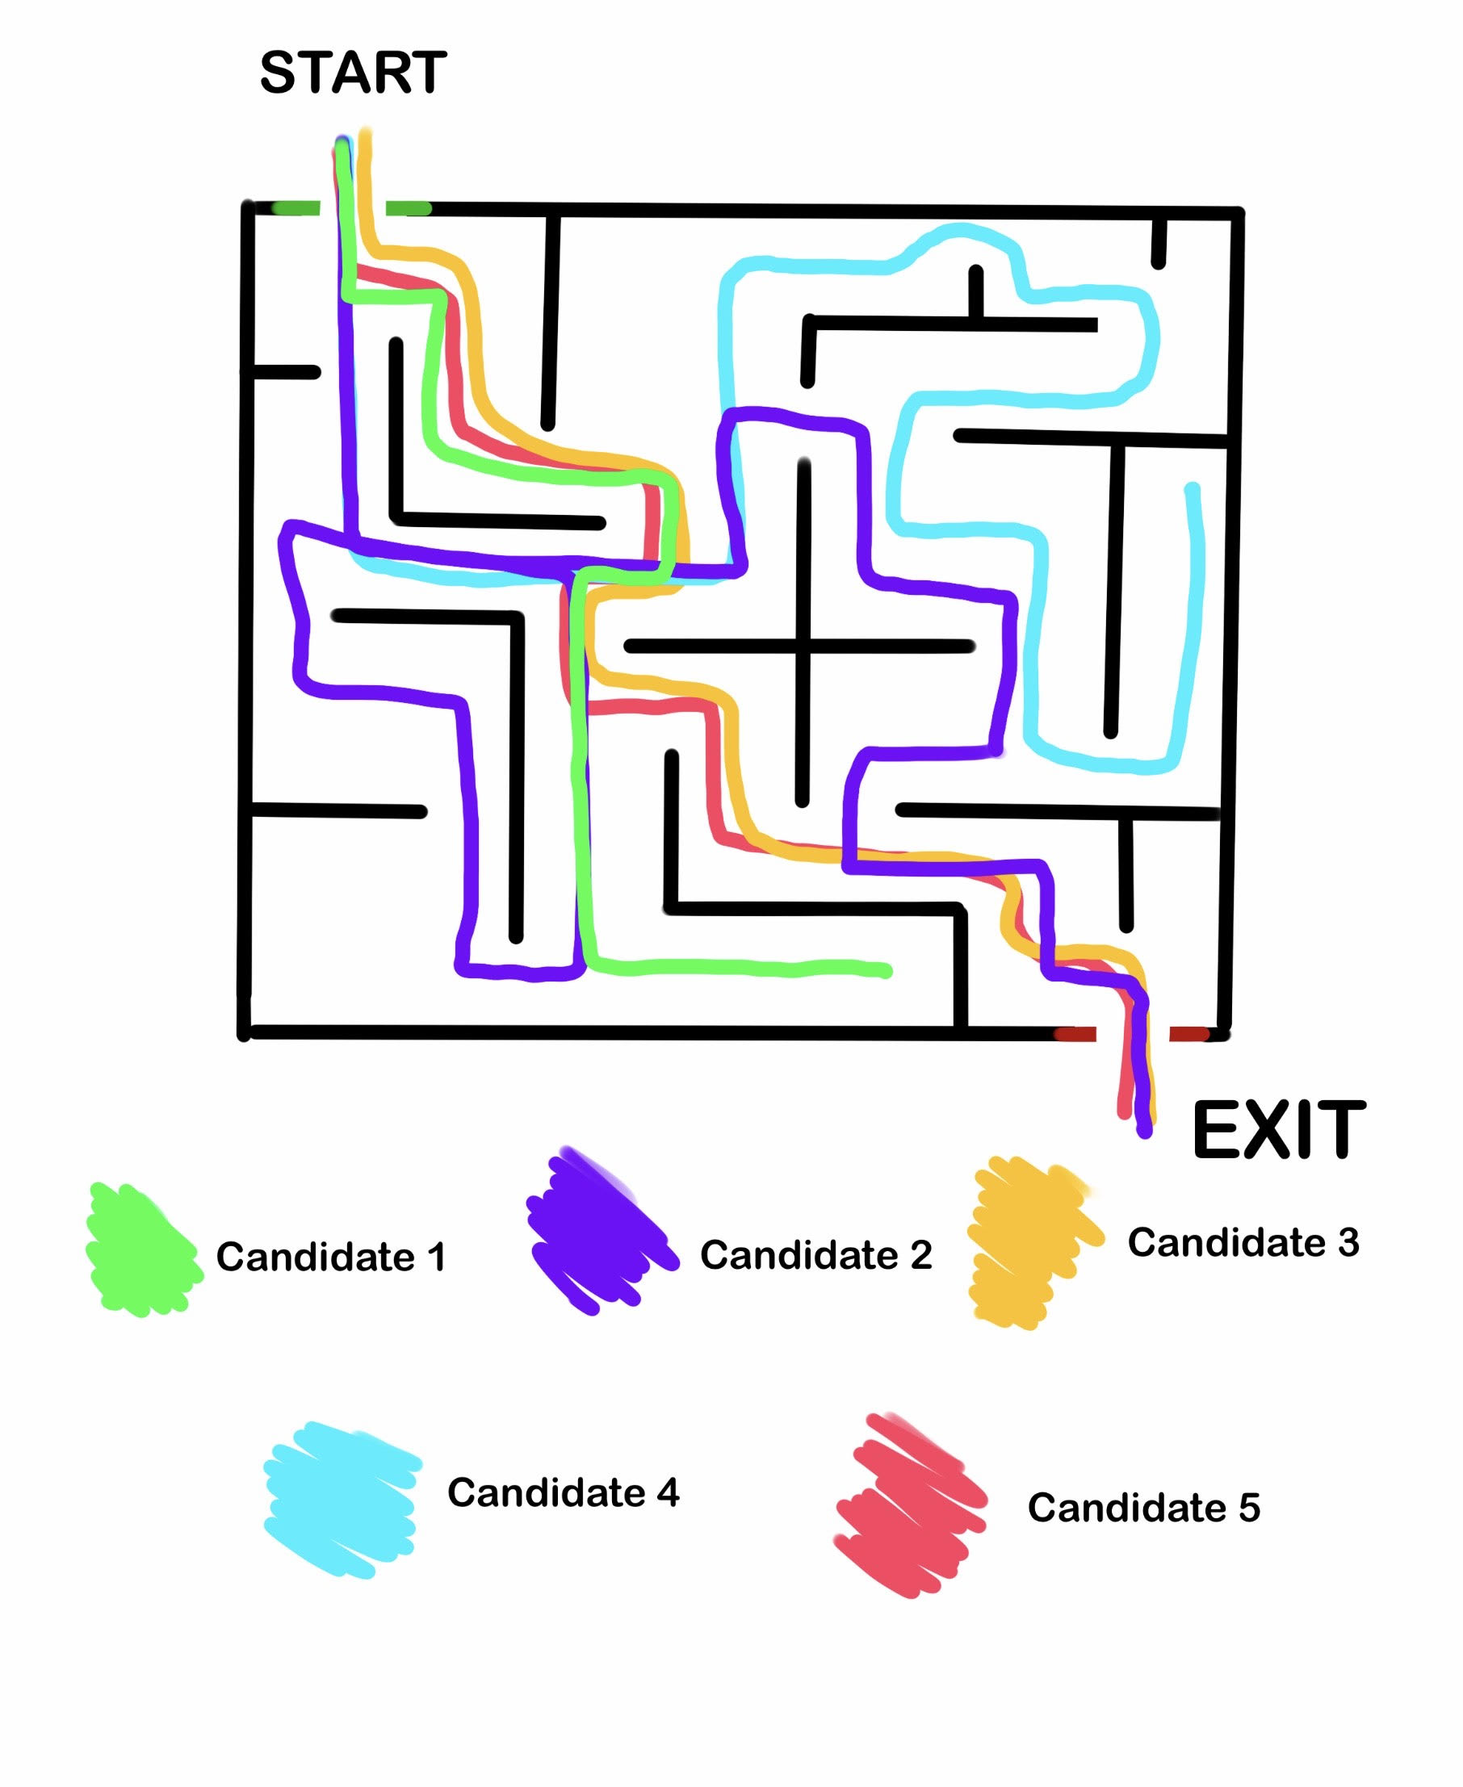
Metric Cognitive Maps
This is used to find the best possible route through a maze by using the data of previous tests.

Slide 10
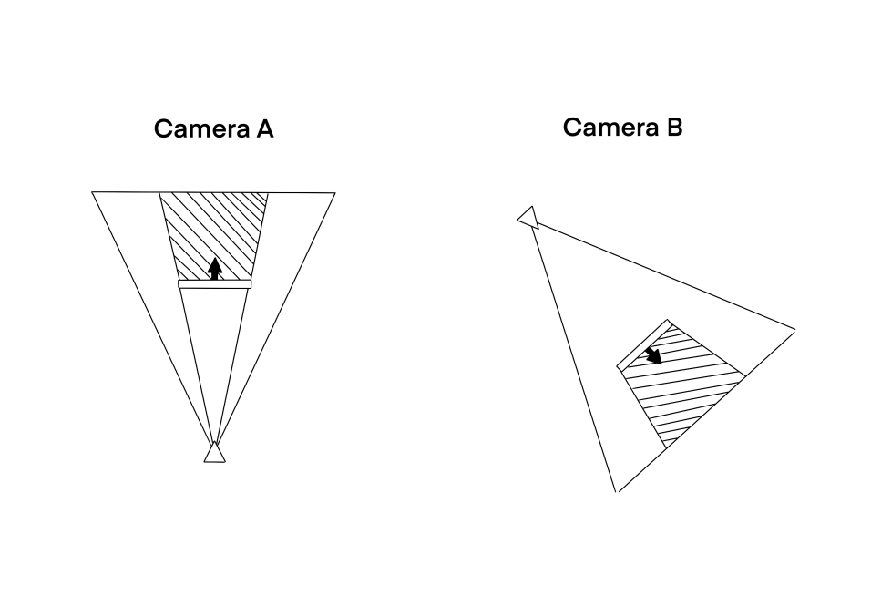
Camera Manipulation
Simple camera trickery used in creating looping corridors, infinitely ascending/descending staircases, portals and much more.
Notes:
Some of the Non-Euclidean aspects I intend on developing will have near similarities to the method in which the Portal games use their seamless transitions through each of the portals. However instead of creating a small surface that the player can see visually, I intend on having these transitions placed within the game's environment at all times that will not be noticeable until the player has a moment of realisation. This can be done within Unity rather simply. As it uses two separate cameras (let's say cameras A and B) and places them so they are looking towards a screen at two separate points within the level. Both of these cameras will orbit their screen as they essentially replicate the player's camera movements. Camera A will project the perspective of camera B onto a screen that is situated with A to get the image of the opposite side. As the player moves and looks through the screen, they should see the current perspective of camera B.

Slide 11
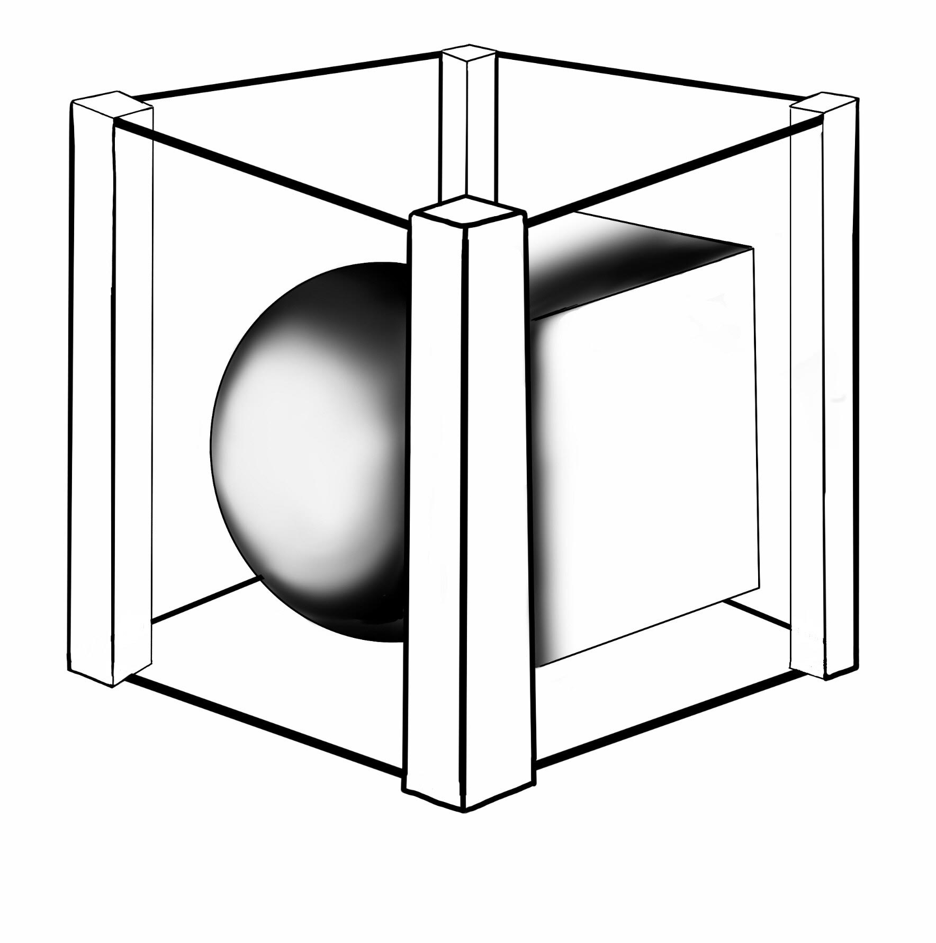
Shader Buffers
Stencil Buffering is a technique used to create a mask on an object that will completely disregard pixels and only show what is necessary.
Notes:
Stencil Buffering is a technique used to create a mask on an object that will completely disregard pixels and only show what is necessary. The stencil can be used as an alpha mask on the face of a shape. The example given on the web page describes it being similar to looking through a window and seeing a mountainscape. What it does it is basically hides everything that is outside the view of the window by the marking pixels between the frame with an arbitrary value of 1. This value will be used to signify that anything marked with the value of 1 within the frame will be kept and anything else will be disregarded.

Slide 12
How is it going to be created?
Notes:
I aim to use the Agile methodology closely as I going to ensure a consistent level of work is being completed over the duration of a 16 week period. This allows for a game level to be created every 2 weeks as part of a sprint plan I'm devising. Furthermore, within this time I will be running QA tests frequently to ensure that the Non-Euclidean geometry is working as intended.

Slide 13
What is my test plan for the experiment?
Notes:
I aim for my experiment to take these feelings of confusion to test a user's efficiency within a simple navigational task. I will begin the experiment by handing them a questionnaire which will ask if they've ever had any experience with games before and to see their overall experience with games. Then after they've finished the questionnaire and the task has been completed, I'll hand them a second questionnaire which will ask how they found the experiment. On completion, they will then be asked to go through a different version of the same level but with more Non-Euclidean elements and then complete a third questionnaire. Again, asking how they found the test.

Slide 14
Data Collection
How is data going to be collected.
How will this data be stored?
Notes:
Data Collection: To gather the data needed for this experiment, the aforementioned questionnaire will be the primary source of this research as I have tailored all of the questions to be relevant towards my hypotheses. I have not included anything that is personal to the participants as the research does not require them.
How will the data be stored?: The data will be stored within a simple Excel spreadsheet document as it keeps everything together and makes it easier to calculate the percentages when the experiment has concluded.

Slide 15
Ethical Considerations
Nausea and anxiety.
Illness associated with consistent computer use.
Withdrawal from the experiment.
Covid-19 safety.
Notes:
Ethical Considerations: With the experiment being a psychological test and the safety of the participants and faculty being the most high priority. I have taken consideration of numerous risks and have thought of ways that can reduce the level of likely-hood towards both parties. The following subsections will address these and explain how they will be followed within the experiment.
Nausea and anxiety: With the experiment dealing with the disorientation of participants and how they process the Non-Euclidean elements. My main worry is that the candidate may be prone to nausea and the test might induce anxiety. I aim to alleviate some of these feelings by giving the participant an in depth explanation on Non-Euclidean geometry beforehand and allow for them to leave if they do not feel comfortable with participating.
Illness associated with computer use: A common form of illness that may occur when using a computer for an extended period of time is either RSI or eye straining. Either of which are deemed a main cause for concern when conducting the experiment as eye straining can lead to visual impairment and high levels of pain where as RSI may possibly lead to a posture deformity. I hope to alleviate this by giving the candidate a brief moment to take a break in which they can recuperate themselves and come back to the test and continue. Another cause for concern is the matter of headaches or migraines. To combat this, I'm allowing for the candidate to withdraw from the experiment if they are starting to feel these such sensations. A member of staff will also be around if they require any immediate help.
Covid-19: Covid-19 is still being considered a threat at the current moment. Precautionary measures will be taken very seriously when running the experiment to avoid any infections towards the candidates and those in close proximity to the research station. So to make sure everything runs perfectly: - Face coverings must be worn at all times; - A risk assessment of the equipment will be completed; - Social distancing will be enforced before anything proceeds; - The equipment will be sanitised after every use.

Slide 16
Any questions?

